Slide 1
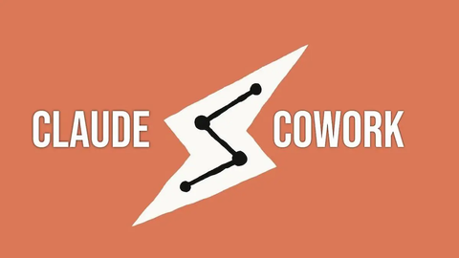
Claude Cowork
Data SAIL – Tech News

Slide 2

OpenClaw and OpenAI
(Last week’s presentation update)
Peter Steinberg, the creator of open claw has joined OpenAI to “bring agents to everyone”.
Nevertheless, OpenClaw will stay open source through a foundation per comments of the creator.

Slide 3

What is Claude Cowork?
Important to note that it is not Claude with extra features.
Designate it a folder, give it instructions and let it work autonomously.
It may work for hours at a time!
Needs a paid subscription (cheapest option 20$ monthly)

Slide 4
Use Cases
Coding capabilities (Claude Code).
Folder structuring.
Extract data from spreadsheets, PDFs, and generate clean Excel reports with analysis.
Compile research from multiple sources into a cohesive report
Generate a daily briefing from Slack, Notion, Jira, and other tools.

Slide 5
Risks and Problems
Users are reproting it ”eats up the RAM”. You may want to consider for a non personal laptop.
Prompt injection. Hidden or malicious instructions in files or web data can trick the AI into doing something harmful.
If you grant broad access, the tool could inadvertently or accidentally affect files you didn’t intend it to
Still in research preview.

